Slide 1
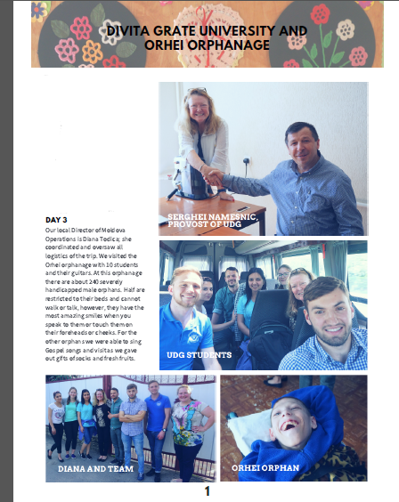
I traveled to Moldova April 29-May 8 to meet with representatives of University Divitia Gratiae (UDG) and to work with students of the school and represen-tatives of Youth for Christ to carry out Save the Orphans’ programs in Moldova. DAYS 1-2
I was graciously picked up at the airport and able to stay on the Campus of the Divita Gratiae University (UDG). I enjoyed meeting with faculty and
students of the Master of Social Work (MSW) program. I was also able to meet with Dr. Dumitru Sevastian, the Dean of Faculty of Theology and Serghei Namesnic, the Provost of University Divitia Gratiae.
Day 3
Our local Director of Moldova Opera-tions is Diana Todica; she coordinated and oversaw all logistics of the trip. We visited the Orhei orphanage with 10 students and their guitars. At this orphanage there are about 240 severely handicapped male orphans. Half are restricted to their beds and cannot walk or talk, however, they have the most amazing smiles when you speak to them or touch them on their foreheads or cheeks. For the other orphans we were able to sing Gospel songs and visit as we gave out gifts of socks and fresh fruits.

Slide 2
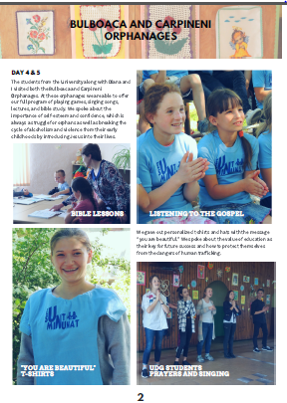
DAYS 4-5 The students from the University along with Diana and I visited both the Bulboaca and Carpineni Orphanages. At these orphanages we are able to offer our full program of playing games, singing songs, lectures, and bible study. We spoke about the importance of self-esteem and confidence, which is always a struggle for orphans as well as breaking the cycle of alcoholism and violence from their early childhoods by introducing Jesus into their lives.
We gave out personalized t-shirts and hats with the message “You are beautiful.” We spoke about the value of education as their key for future success and how to protect themselves from the dangers of human trafficking.

Slide 3
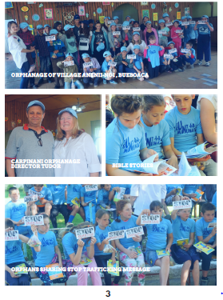

Slide 4
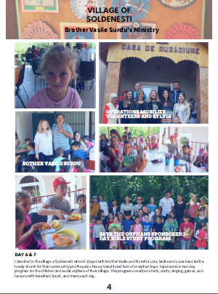
DAYS 6-7
I traveled to the village of Soldanesti where I stayed with brother Vasile Surdu and his wife Lucia. Vasile and Lucia have built a lovely church for their community and they also have a transitional home for orphan boys. I sponsored a two-day program for the children and social orphans of their village. This program consisted of arts, crafts, singing, games, and lessons with breakfast, lunch, and treats each day.

Slide 5
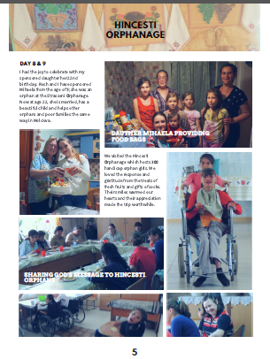
DAYS 8-9 I had the joy to celebrate with my spon-sored daughter her 22nd birthday. My husband Roch and I have sponsored Mihaela from the age of 9; she was an orphan at the Strasseni Orphanage. Now at age 22, she is married, has a beautiful child and helps other orphans and poor families the same way in Moldova.
We visited the Hincesti
Orphanage which hosts 300 handicap orphan girls. We loved the response and
gratitude from the treats of fresh fruits and gifts of socks. Their smiles warmed our hearts and their appre-ciation alone made the trip worthwhile.

Slide 6
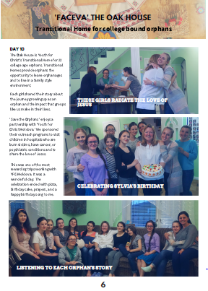
Day 10
The Oak House is Youth for
Christ's Transitional Home for 22
College-age orphans. Transitional
Homes provide orphans the
opportunity to leave orphanages
and to live in a family style
environment.
Each girl shared their story about
the journey growing up as an
orphan and the impact that groups
like us make in their lives.
This was one of the most reward-ing trips working with YFC-Moldova. It was a wonderful day. The celebration ended with pizza, birthday cake, prayers, and a happy birthday song to me.
'Save the Orphans' enjoys a part-nership with 'Youth for Christ Moldova.' We sponsored
their outreach programs to visit
children in hospitals who are
burn victims, have cancer, or
psychiatric conditions and to
share the love of Jesus.

Slide 7
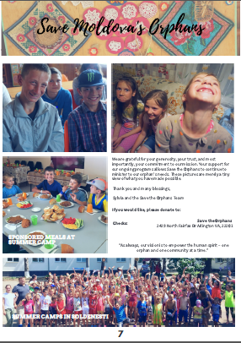
We are grateful for your generosity, your trust, and most
importantly, your commitment to our mission. Your support for our ongoing programs allows Save the Orphans to continue to minister to our orphan's needs. These pictures are merely a tiny view of what you have made possible.
Thank you and many blessings,
Sylvia and the Save the Orphans Team
If you would like, please donate to:
Save Moldova's Orphans
Checks: Save the Orphans
2429 North Fairfax Dr., Arlington VA, 22201
“As always, our vision is to empower the human spirit – one
orphan and one community at a time.”

